Slide 1


COVER
DANIEL HILLS
DIGITAL MARKETING SPECIALIST
Presenting to :
Jane Sennett
Julia McVittie Michelle Errington
Thursday 3rd October 2024

Slide 2





AGENDA
Campaign project management
Key Considerations
Output examples
Questions
1

Slide 3


MARKETING CAMPAIGN PROJECT PROCESS
BRIEFING
STRATEGY
PLANNING
ACTIVATION
CAMPAIGN MGMT
WRAP UP
We MUST complete each stage of the process to ensure ensure marketing performance excellence!
Best in Class
Best in Class
Best in Class
2

Slide 4


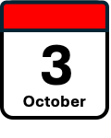

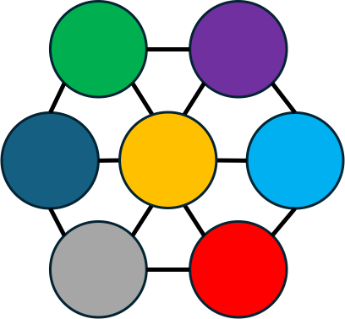





3
October
$
BRIEFING
SITE
MOT
BUDGET
COMPETITOR
ANALSYS
TRACKING/
FEEDBACK
EVENTS
OBJECTIVES
STRATEGY
Audience
Channel
Communications
3

Slide 5


PLANNING PHASE
Markets
Channels
Message
Audiences
Platforms
Activate
Budgets
Metrics
Formats
Flighting
The planning phase brings audiences and channels, as per the strategy phase together into a formalized marketing communications plan. On completion of the planning phase, we are well positioned to go to market with the assurance that we have carried out a diligent process, and that our campaigns have the best possible chance of being successful
4

Slide 6


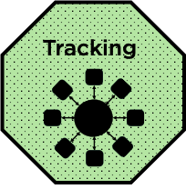

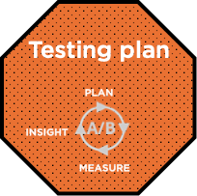
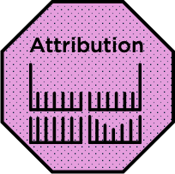
ACTIVATION + TESTING
Hmm! Could CTV video work 4 us?
CAMPAIGN MGMT
Daly Checking
Weekly Reporting
Test + Learn
Optimisation
Insights
PCA
Re-plan
15” YouTube is up this week!
IMPLIMENT
5

Slide 7

What went well / what needed a re-think?
1. Clearly Identify Campaign Objectives
2. Identify Your Target Audience
3. Keyword Research
4. Compelling Ad Copy
5. Landing Page Optimisation
6. Ad Extensions
7. Negative Keywords
8. Tracking + Measurement
9. Ongoing Optimization
BRINGING THE PROCESS TO LIFE:
PAID SEARCH EXAMPLE
KPI EXAMPLE
Objective:
Sales Funnel
Primary Metrics:
Leads, £CPL, CR%
Secondary Metrics:
Clicks, CTR%, £CPC
6
Notes:
Setting up a successful B2B search campaign involves several key steps: 1. : Clearly define your campaign objectives. Are you looking to generate leads, increase website traffic, or drive conversions? Understanding your goals will shape the rest of your campaign strategy.
2. Identify Your Target Audience: Understand your ideal B2B customers and tailor your campaign to reach them. Consider factors such as industry, job titles, company size, and geographic location.
3. Keyword Research: Conduct thorough keyword research to identify the terms and phrases your target audience is likely to use when searching for your products or services. Use tools like Google Keyword Planner, SEMrush, or Ahrefs to identify relevant keywords with sufficient search volume and manageable competition.
4. Compelling Ad Copy: Create compelling ad copy that resonates with your B2B audience. Highlight the unique value propositions of your products or services and include a strong call-to-action.
5. Landing Page Optimization: Ensure that your landing pages are optimized to align with your ad messaging and provide a clear path for visitors to take the desired action, whether it's downloading a whitepaper, requesting a demo, or making a purchase.
6. Ad Extensions: Take advantage of ad extensions such as sitelink extensions, callout extensions, and structured snippet extensions to provide additional information and improve ad visibility.
7. Negative Keywords: Use negative keywords to prevent your ads from showing for irrelevant searches and to improve the overall quality of your traffic.
8. Tracking and Measurement: Implement tracking tools such as Google Analytics and conversion tracking to measure the performance of your campaign. Monitor key metrics such as click-through rate (CTR), conversion rate, and cost per acquisition (CPA).
9. Ongoing Optimization: Regularly review and optimize your campaign based on performance data. Test different ad variations, adjust bid strategies, and refine targeting to improve results over time.

Slide 8

It’s a trap!
WHAT ALWAYS TRIPS PEOPLE UP
7
Notes:
Everything in writing
Scope creep – planning away from agreed KPIs
Project management – sticking to time and managing all parties (giving them enough time)
Trafficking, tagging and tracking issues (inc CRM integration) – make time for testing
Creative specs - ensure all are collected, distributed, and built to spec
Agreed delivery metrics – whos stats are we going with
Transparency and attribution – suppliers place in the funnel

Slide 9
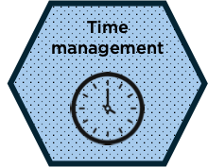
It’s a trap!
WHAT ALWAYS TRIPS PEOPLE UP
In a complex marketing environment, effective time management is not solely about handling individual tasks on ones own desk. Given the multitude of moving pieces and interconnected responsibilities, it is all too common for critical deadlines to slip through the cracks. Therefore, it becomes crucial to also manage other members and stakeholders to ensure all the moving parts come together. By doing so, we can proactively prevent important deadlines from being overlooked or delayed, ensuring the smooth and efficient progression of campaigns.
7
Notes:
Everything in writing
Scope creep – planning away from agreed KPIs
Project management – sticking to time and managing all parties (giving them enough time)
Trafficking, tagging and tracking issues (inc CRM integration) – make time for testing
Creative specs - ensure all are collected, distributed, and built to spec
Agreed delivery metrics – whos stats are we going with
Transparency and attribution – suppliers place in the funnel

Slide 10
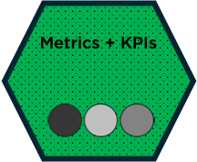
It’s a trap!
WHAT ALWAYS TRIPS PEOPLE UP
Establishing clear campaign outcomes from the outset is absolutely crucial to confidently drive a strategy and planning process that compellingly delivers a campaign meeting both marketing and business objectives.
7
Notes:
Everything in writing
Scope creep – planning away from agreed KPIs
Project management – sticking to time and managing all parties (giving them enough time)
Trafficking, tagging and tracking issues (inc CRM integration) – make time for testing
Creative specs - ensure all are collected, distributed, and built to spec
Agreed delivery metrics – whos stats are we going with
Transparency and attribution – suppliers place in the funnel

Slide 11
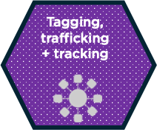
It’s a trap!
WHAT ALWAYS TRIPS PEOPLE UP
The processes of tagging, trafficking, and testing consistently require more time than initially estimated. Anomalies and issues are prone to arise, necessitating careful and methodical attention. It is imperative to approach this stage with patience and precision, refraining from haste to ensure thoroughness and accuracy.
7
Notes:
Everything in writing
Scope creep – planning away from agreed KPIs
Project management – sticking to time and managing all parties (giving them enough time)
Trafficking, tagging and tracking issues (inc CRM integration) – make time for testing
Creative specs - ensure all are collected, distributed, and built to spec
Agreed delivery metrics – whos stats are we going with
Transparency and attribution – suppliers place in the funnel

Slide 12

It’s a trap!
WHAT ALWAYS TRIPS PEOPLE UP
It is vital to collate ALL of the creative specifications for every format with every platform or partner. This saves time and mistakes when creative and copy is being produced and reduces the occurrences of human error. NEVER rush this stage!
7
Notes:
Everything in writing
Scope creep – planning away from agreed KPIs
Project management – sticking to time and managing all parties (giving them enough time)
Trafficking, tagging and tracking issues (inc CRM integration) – make time for testing
Creative specs - ensure all are collected, distributed, and built to spec
Agreed delivery metrics – whos stats are we going with
Transparency and attribution – suppliers place in the funnel

Slide 13

It’s a trap!
WHAT ALWAYS TRIPS PEOPLE UP
Scope creep, the gradual addition of new requirements beyond the original scope, is a frequent challenge. Once the strategy has received approval and planning is underway, it's important to refrain from introducing additional requirements into the management information system (MIS). Doing so leads to duplications and necessitates reworking the planning process, ultimately consuming more time during the campaign planning phase.
7
Notes:
Everything in writing
Scope creep – planning away from agreed KPIs
Project management – sticking to time and managing all parties (giving them enough time)
Trafficking, tagging and tracking issues (inc CRM integration) – make time for testing
Creative specs - ensure all are collected, distributed, and built to spec
Agreed delivery metrics – whos stats are we going with
Transparency and attribution – suppliers place in the funnel

Slide 14
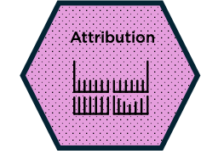
It’s a trap!
WHAT ALWAYS TRIPS PEOPLE UP
Attribution must be carefully considered during the planning phase. High-funnel activities, such as video engagements, will invariably yield a higher cost per lead or sale compared to search, for example. Nonetheless, all these activities contribute to the ultimate action.
7
Notes:
Everything in writing
Scope creep – planning away from agreed KPIs
Project management – sticking to time and managing all parties (giving them enough time)
Trafficking, tagging and tracking issues (inc CRM integration) – make time for testing
Creative specs - ensure all are collected, distributed, and built to spec
Agreed delivery metrics – whos stats are we going with
Transparency and attribution – suppliers place in the funnel

Slide 15

It’s a trap!
WHAT ALWAYS TRIPS PEOPLE UP
Finally, and perhaps most significantly, documenting everything in a systematic manner enables the prevention of errors and allows other team members to provide assistance if needed. Moreover, it establishes a documented record in case of any issues with third parties.
7
Notes:
Everything in writing
Scope creep – planning away from agreed KPIs
Project management – sticking to time and managing all parties (giving them enough time)
Trafficking, tagging and tracking issues (inc CRM integration) – make time for testing
Creative specs - ensure all are collected, distributed, and built to spec
Agreed delivery metrics – whos stats are we going with
Transparency and attribution – suppliers place in the funnel

Slide 16
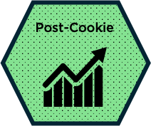
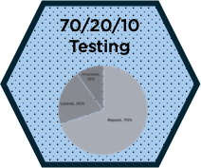
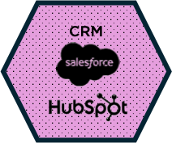

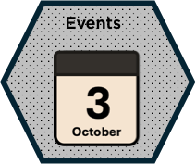
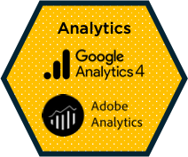

ADDITIONAL CONSIDERATIONS
Plan around cookies by using alternative tracking methods
Always assign adequate testing budget into the campaigns to learn and exploit developments
Ensure CRMs have been synchronised with the campaign tracking parameters
Be ready to exploit developments in AI as they emerge i.e. copy writing, creative, tracking etc.
Be mindful of the events calendar so you can plan budgets + campaigns accordingly
As with CRM, take extra time to ensure tracking is synchronized with the campaigns
Website MOT is vital to ensure there are product pages to support the campaigns
7

Slide 17


IN SUMMARY
Follow the established planning framework
Focus on the key metrics for each channel
70/20/10 – Always Be Testing
Attribution
8

Slide 18




OUTPUT EXAMPLES
BRIEFING
DOCUMENT
STRATEGY
PROCESS
REPORTING
DASHBOARD
POST-
CAMPAIGN
REVIEW
9

Slide 19
COVER
QUESTIONS?
Linkedin: /DanHills
Email: Dan@PortlandRockConsortium.com
Whatsapp: 07949562946

